Slide 1



IBM Data Science Capstone Project – Space X
LOKA AKASH REDDY

Slide 2


Outline
Executive Summary
Introduction
Methodology
Results
Conclusion
Appendix
2

Slide 3

Executive Summary
Summary of methodologies
Data collection
Data wrangling
EDA with data visualization
EDA with SQL
Building an interactive map with Folium
Building a Dashboard with Plotly Dash
Predictive analysis (Classification)
Summary of all results
Exploratory data analysis results
Interactive analytics demo in screenshots
Predictive analysis results
3

Slide 4

Introduction
Project background and context
We predicted if the Falcon 9 first stage will land successfully. SpaceX advertises Falcon 9 rocket launches on its website, with a cost of 62 million dollars; other providers cost upward of 165 million dollars each, much of the savings is because SpaceX can reuse the first stage.
Therefore, if we can determine if the first stage will land, we can determine the cost of a launch. This information can be used if an alternate company wants to bid against SpaceX for a rocket launch.
Common problems that needed solving.
What influences if the rocket will land successfully?
The effect each relationship with certain rocket variables will impact in
determining the success rate of a successful landing.
What conditions does SpaceX have to achieve to get the best results and ensure the best rocket success landing rate.
4

Slide 5

Methodology
Data collection methodology:
SpaceX Rest API
(Web Scrapping) from Wikipedia
Performed data wrangling (Transforming data for Machine Learning)
One Hot Encoding data fields for Machine Learning and dropping irrelevant columns
Performed exploratory data analysis (EDA) using visualization and SQL
- Plotting : Scatter Graphs, Bar Graphs to show relationships between variables to show patterns of data.
Performed interactive visual analytics using Folium and Plotly Dash
Performed predictive analysis using classification models
How to build, tune, evaluate classification models
5

Slide 6

Methodology
6

Slide 7



Methodology
The following datasets was collected by
We worked with SpaceX launch data that is gathered from the SpaceX REST API.
This API will give us data about launches, including information about the rocket used, payload delivered, launch specifications, landing specifications, and landing outcome.
Our goal is to use this data to predict whether SpaceX will attempt to land a rocket or not.
The SpaceX REST API endpoints, or URL, starts with api.spacexdata.com/v4/.
Another popular data source for obtaining Falcon 9 Launch data is web scraping Wikipedia using BeautifulSoup.
SpaceX API
API
returns SpaceX data in
.JSON
Get HTML
Response from Wikipedia
Web Scrapping
Use SpaceX REST API
Normalize data into flat data file such as .csv
Extract data using beautiful soup
Normalize data into flat data file such as .csv
7

Slide 8
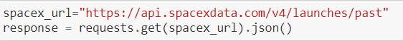
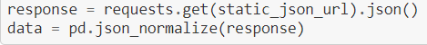
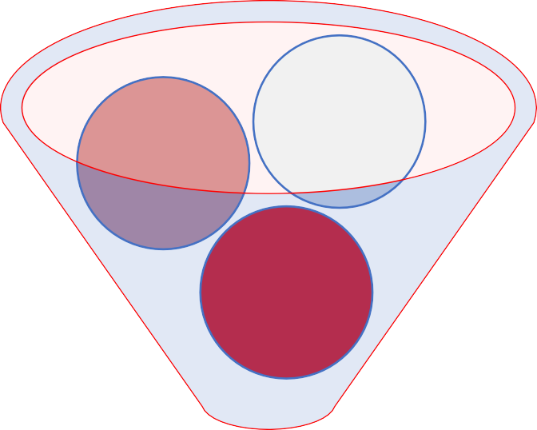
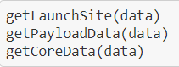
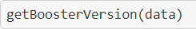
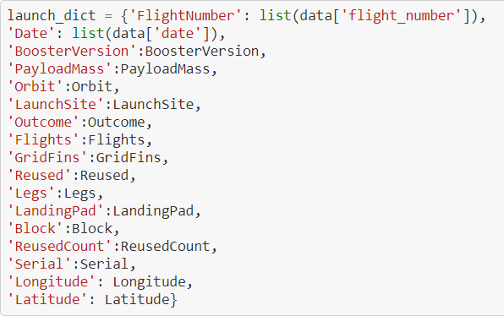
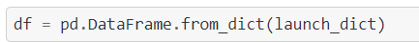
Data collection –
SpaceX API
1 .Getting Response from API
simplified flow chart
2. Converting Response to a .json file
3. Apply custom functions to clean data
Filter DF for Falcon 9 only
/ Clean Data
4. Assign list to dictionary then dataframe
Use SpaceX REST API
API returns SpaceX data in .JSON
Normalize data into flat data file such as .csv
5. Filter dataframe and export to flat file (.csv)
GitHub URL to Notebook
8

Slide 9
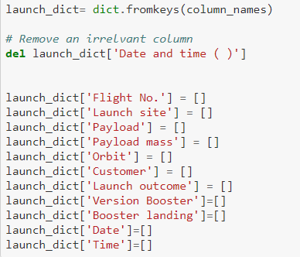

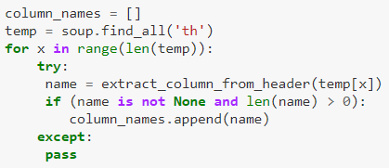
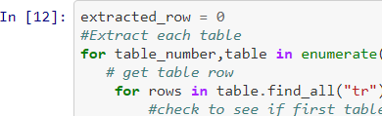
1 .Getting Response from HTML
simplified flow chart
5. Creation of dictionary
Data collection – Web Scrapping
2. Creating BeautifulSoup Object
Data collection – Web
scraping
Present your web scraping process use key
phrases and flowcharts
Add the GitHub URL of the completed web scraping notebook, as an external reference and peer-review purpose
3. Finding tables
4. Getting column names
Get HTML
Response from Wikipedia
Extract data using beautiful soup
Parse HTML table into a List -> Dictionary
6. Appending data to keys (refer) to notebook block 12
Normalize data into flat data file such as .csv
7. Converting dictionary to dataframe
8. Dataframe to .CSV
GitHub URL to Notebook
9

Slide 10
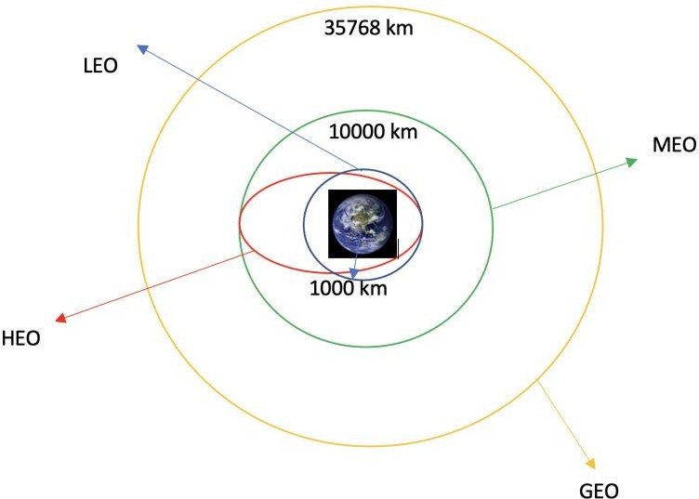
Data Wrangling
Data wrangling
Introduction
In the data set, there are several different cases where the booster did not land successfully. Sometimes a landing was attempted but failed due to an accident; for example, True Ocean means the mission outcome was successfully landed to a specific region of the ocean while False Ocean means the mission outcome was unsuccessfully landed to a specific region of the ocean. True RTLS means the mission outcome was successfully landed to a ground pad False RTLS means the mission outcome was unsuccessfully landed to a ground pad. True ASDS means the mission outcome was successfully landed on a drone ship False
ASDS means the mission outcome was unsuccessfully landed on a drone ship.
We mainly convert those outcomes into Training Labels with 1 means the booster successfully
landed 0 means it was unsuccessful.
GitHub URL to Notebook
Each launch aims to an dedicated orbit, and here are some common orbit types:
Process
Perform Exploratory Data Analysis EDA on dataset
Calculate the number of launches at each site
Calculate the number and occurrence of each orbit
Calculate the number and occurrence of mission outcome per orbit type
Export dataset as
.CSV
Create a landing outcome label from Outcome column
Work out success rate for every landing in dataset
Diagram showing common orbit types
SpaceX uses
10

Slide 11



EDA with Data Visualization
EDA with data visualization
Scatter Graphs being drawn:
Flight Number VS. Payload Mass Flight Number VS. Launch Site Payload VS. Launch Site
Orbit VS. Flight Number Payload VS. Orbit Type Orbit VS. Payload Mass
Scatter plots show how much one variable is affected by another. The relationship between two variables is called their correlation . Scatter plots usually consist of a large body of data.
Bar Graph being drawn:
Mean VS. Orbit
A bar diagram makes it easy to compare sets of data between different groups at a glance. The graph represents categories on one axis and a discrete value in the other. The goal is to show the relationship between the two axes. Bar charts can also show big changes in data over time.
Line Graph being drawn:
Success Rate VS. Year
Line graphs are useful in that they show data variables and trends very clearly and can help to make predictions about the results of data not yet recorded
GitHub URL to Notebook
11

Slide 12

EDA with SQL
EDA with SQL
Performed SQL queries to gather information about the dataset.
For example of some questions we were asked about the data we needed information about. Which we are using SQL queries to get the answers in the dataset :
Displaying the names of the unique launch sites in the space mission
Displaying 5 records where launch sites begin with the string 'KSC’
Displaying the total payload mass carried by boosters launched by NASA (CRS)
Displaying average payload mass carried by booster version F9 v1.1
Listing the date where the successful landing outcome in drone ship was achieved.
Listing the names of the boosters which have success in ground pad and have payload mass greater than 4000 but less than 6000
Listing the total number of successful and failure mission outcomes
Listing the names of the booster_versions which have carried the maximum payload mass.
Listing the records which will display the month names, successful landing_outcomes in ground pad ,booster versions, launch_site for the months in year 2017
Ranking the count of successful landing_outcomes between the date 2010-06-04 and 2017-03-20 in descending order.
GitHub URL to Notebook
12

Slide 13
Building an interactive map with Folium
To visualize the Launch Data into an interactive map. We took the Latitude and Longitude Coordinates at each launch site and added a Circle Marker around each launch site with a label of the name of the launch site.
We assigned the dataframe launch_outcomes(failures, successes) to classes 0 and 1 with Green and Red markers on the map in a MarkerCluster()
Using Haversine’s formula we calculated the distance from the Launch Site to various landmarks to find various trends about what is around the Launch Site to measure patterns. Lines are drawn on the map to measure distance to landmarks
Example of some trends in which the Launch Site is situated in.
Are launch sites in close proximity to railways? No
Are launch sites in close proximity to highways? No
Are launch sites in close proximity to coastline? Yes
Do launch sites keep certain distance away from cities? Yes
GitHub URL to Notebook
13

Slide 14
Built an interactive dashboard with Flask and Dash
Build a Dashboard with Plotly Dash
Used Python Anywhere to host the website live 24/7 so your can play around with the data and view the data
- The dashboard is built with Flask and Dash web framework.
Graphs
- Pie Chart showing the total launches by a certain site/all sites
- display relative proportions of multiple classes of data.
- size of the circle can be made proportional to the total quantity it represents.
URL Link to live website
GitHub Link to source code
Scatter Graph showing the relationship with Outcome and Payload Mass (Kg) for the different Booster Versions
It shows the relationship between two variables.
It is the best method to show you a non-linear pattern.
The range of data flow, i.e. maximum and minimum value, can be determined.
Observation and reading are straightforward.

Slide 15

Predictive analysis (Classification)
Predictive analysis (Classification)
BUILDING MODEL
Load our dataset into NumPy and Pandas
Transform Data
Split our data into training and test data sets
Check how many test samples we have
Decide which type of machine learning algorithms we want to use
Set our parameters and algorithms to GridSearchCV
Fit our datasets into the GridSearchCV objects and train our dataset.
EVALUATING MODEL
Check accuracy for each model
Get tuned hyperparameters for each type of algorithms
Plot Confusion Matrix
IMPROVING MODEL
Feature Engineering
Algorithm Tuning
FINDING THE BEST PERFORMING CLASSIFICATION MODEL
GitHub Link to source code
The model with the best accuracy score wins the best performing model
In the notebook there is a dictionary of algorithms with scores at the bottom of the notebook.

Slide 16

Results
Results
Exploratory data analysis results
Interactive analytics demo in screenshots
Predictive analysis results

Slide 17

EDA with Visualization

Slide 18
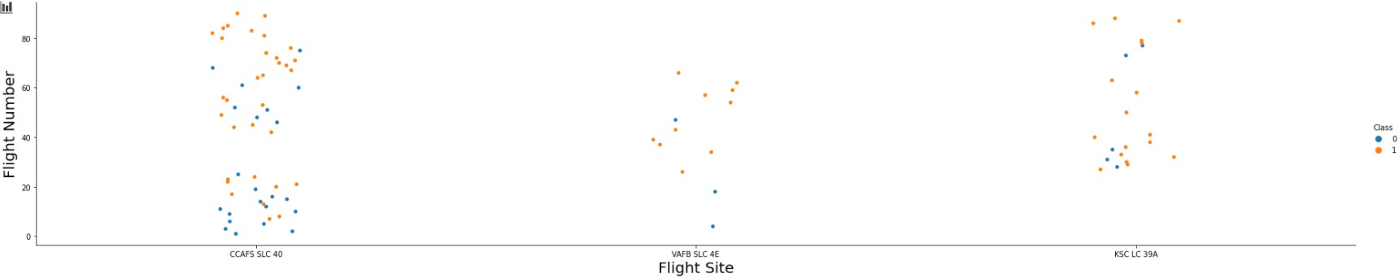
Flight Number vs. Flight Site
The more amount of flights at a launch site the greater the success rate at a launch site.

Slide 19
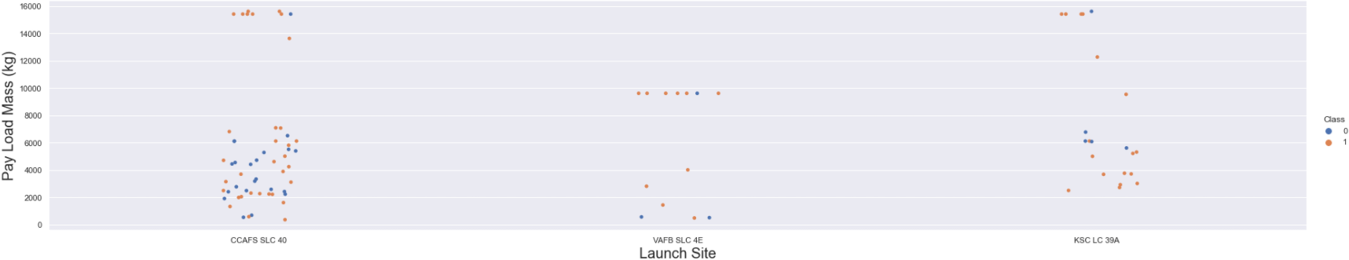
Payload Mass vs. Launch Site
The greater the payload mass for Launch Site CCAFS SLC 40 the higher the success rate for the Rocket. There is not quite a clear pattern to be found using this visualization to make a decision if the Launch Site is dependant on Pay Load Mass for a success launch.

Slide 20
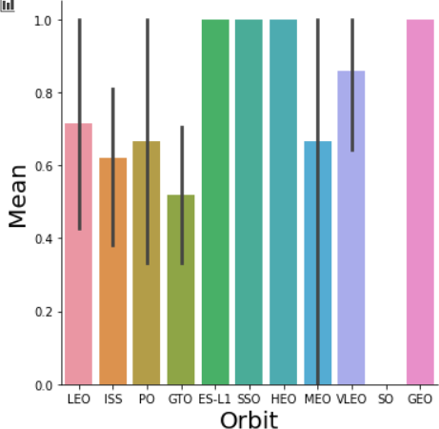
Success rate vs. Orbit type
Orbit GEO,HEO,SSO,ES-L1 has the best Success Rate

Slide 21
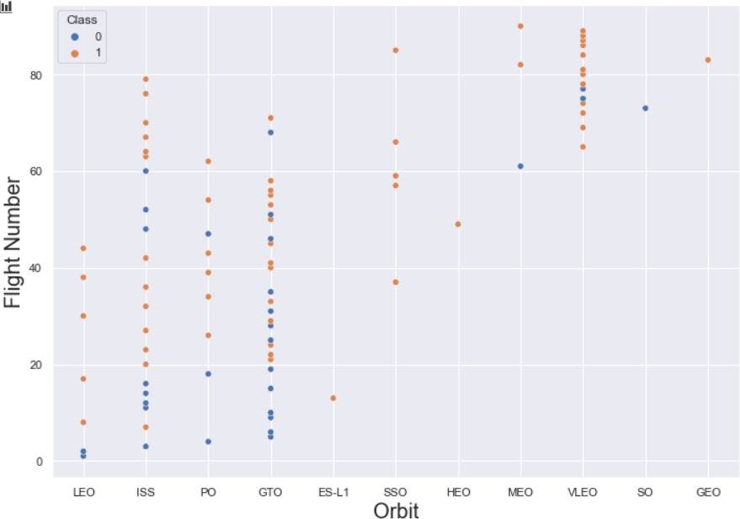
Flight Number vs. Orbit type
You should see that in the LEO orbit the Success appears related to the number of flights; on the other hand, there seems to be no relationship between flight number when in GTO orbit.

Slide 22
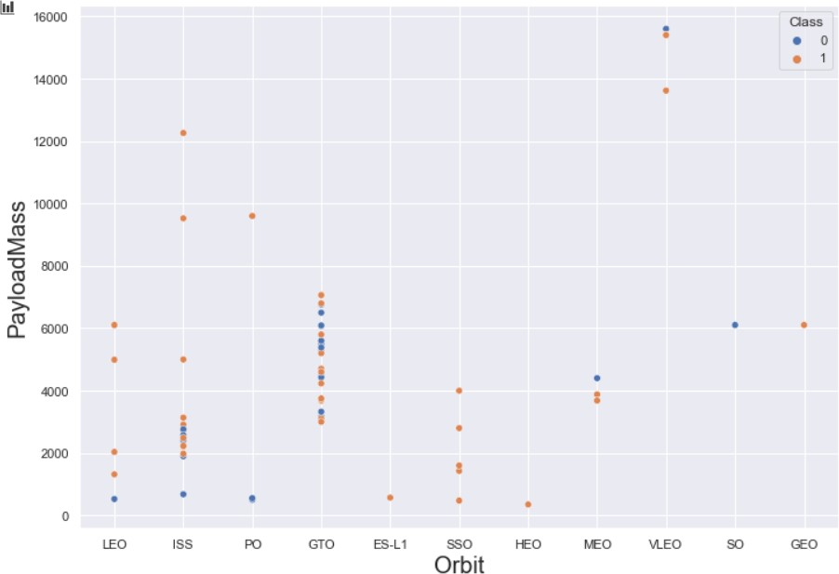
Payload vs. Orbit type
You should observe that Heavy payloads have a negative influence on GTO orbits and positive on GTO and Polar LEO (ISS) orbits.

Slide 23
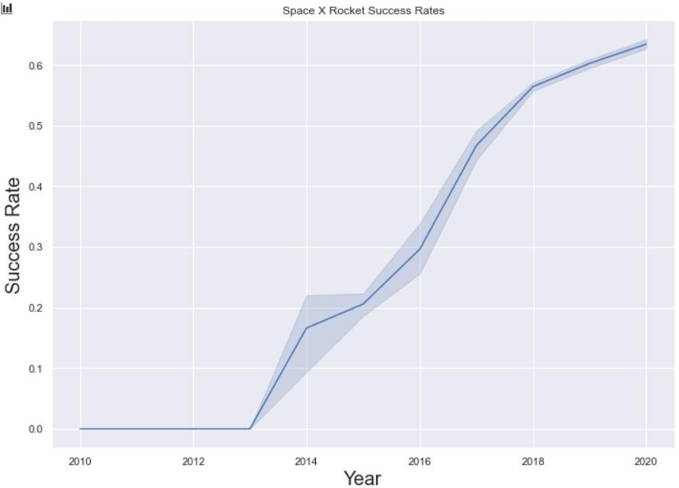
Launch success yearly trend
you can observe that the success rate since 2013 kept increasing till 2020

Slide 24

EDA WITH

Slide 25
Unique Launch Sites
All launch site names
Unique Launch Sites
CCAFS LC-40
CCAFS SLC-40
CCAFS SLC-40
KSC LC-39A
VAFB SLC-4E
SQL QUERY
select DISTINCT Launch_Site
from tblSpaceX
QUERY EXPLAINATION
Using the word DISTINCT in the query means that it will only show Unique values in the Launch_Site column from tblSpaceX

Slide 26
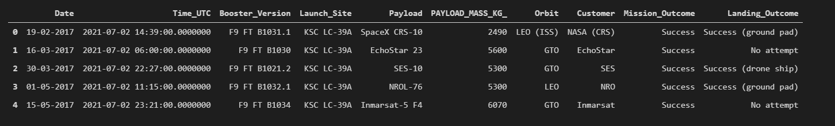
Launch site names begin with `CCA`
SQL QUERY
select TOP 5 * from tblSpaceX
WHERE Launch_Site LIKE 'KSC%'
QUERY EXPLAINATION
Using the word TOP 5 in the query means that it will only show 5 records from tblSpaceX and LIKE keyword has a wild card with the words ‘KSC%’ the percentage in the end suggests that the Launch_Site name must start with KSC.

Slide 27
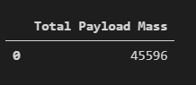
Total Payload Mass by Customer NASA (CRS)
Total payload mass
SQL QUERY
select SUM(PAYLOAD_MASS_KG_) TotalPayloadMass from tblSpaceX where Customer = 'NASA (CRS)'",'TotalPayloadMass
QUERY EXPLAINATION
Using the function SUM summates the total in the column
PAYLOAD_MASS_KG_
The WHERE clause filters the dataset to only perform calculations on Customer NASA (CRS)

Slide 28
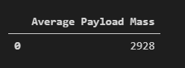
Average Payload Mass carried by booster version F9 v1.1
SQL QUERY
select AVG(PAYLOAD_MASS_KG_) AveragePayloadMass from tblSpaceX
where Booster_Version = 'F9 v1.1'
QUERY EXPLAINATION
Using the function AVG works out the average in the column
PAYLOAD_MASS_KG_
The WHERE clause filters the dataset to only perform calculations on Booster_version F9 v1.1

Slide 29

The date where the successful landing outcome in drone ship was achieved
First successful ground landing date
SQL QUERY
select MIN(Date) SLO from tblSpaceX where Landing_Outcome = ”Success (drone ship)”
QUERY EXPLAINATION
Using the function MIN works out the minimum date in the column Date
The WHERE clause filters the dataset to only perform
calculations on Landing_Outcome Success (drone ship)

Slide 30
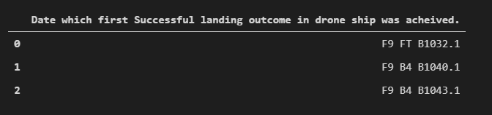
Successful drone ship landing with payload between 4000 and 6000
SQL QUERY
select Booster_Version from tblSpaceX where Landing_Outcome = 'Success (ground pad)’
AND Payload_MASS_KG_ > 4000 AND Payload_MASS_KG_ < 6000
QUERY EXPLAINATION
Selecting only Booster_Version
The WHERE clause filters the dataset to Landing_Outcome =
Success (drone ship)
The AND clause specifies additional filter conditions
Payload_MASS_KG_ > 4000 AND Payload_MASS_KG_ < 6000

Slide 31

Total Number of Successful and Failure Mission Outcomes
SQL QUERY
SELECT(SELECT Count(Mission_Outcome) from tblSpaceX where Mission_Outcome
LIKE '%Success%’) as Successful_Mission_Outcomes,
(SELECT Count(Mission_Outcome) from tblSpaceX where Mission_Outcome LIKE '%Failure%’) as Failure_Mission_Coutcomes
QUERY EXPLAINATION
a much harder query I must say, we used subqueries here to produce the results. The LIKE ‘%foo%’ wildcard shows that in the record the foo phrase is in any part of the string in the records for example.
PHRASE “(Drone Ship was a Success)” LIKE ‘%Success%’
Word ‘Success’ is in the phrase the filter will include it in the dataset

Slide 32
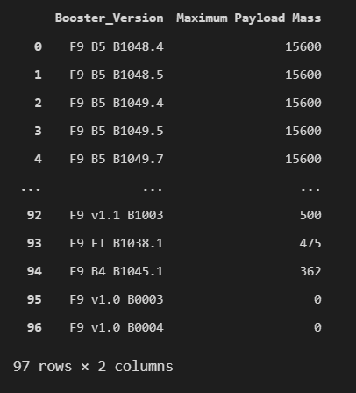
Boosters carried maximum payload
SQL QUERY
SELECT DISTINCT Booster_Version, MAX(PAYLOAD_MASS
_KG_) AS [Maximum Payload Mass]
FROM tblSpaceX GROUP BY Booster_Version ORDER BY [Maximum Payload Mass] DESC
QUERY EXPLAINATION
Using the word DISTINCT in the query means that it will only show Unique values in the Booster_Version column from tblSpaceX
GROUP BY puts the list in order set to a certain condition.
DESC means its arranging the dataset into descending order

Slide 33
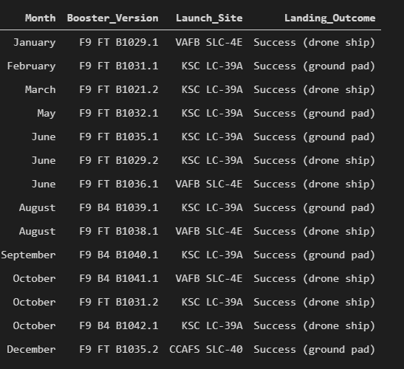
2017 Launch Records
2015 launch records
SQL QUERY
SELECT DATENAME(month, DATEADD(month,
MONTH(CONVERT(date, Date, 105)), 0) - 1) AS Month,
Booster_Version, Launch_Site, Landing_Outcome FROM tblSpaceX
WHERE (Landing_Outcome LIKE N'%Success%') AND
(YEAR(CONVERT(date, Date, 105)) = '2017')
QUERY EXPLAINATION
a much more complex query as I had my Date fields in SQL Server stored as NVARCHAR the MONTH function returns name month. The function CONVERT converts NVARCHAR to Date.
WHERE clause filters Year to be 2017

Slide 34
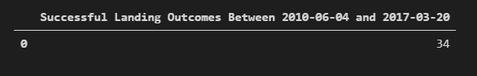
Rank success count between 2010-06-04 and 2017-03-20
SQL QUERY
SELECT COUNT(Landing_Outcome)
FROM tblSpaceX
WHERE (Landing_Outcome LIKE '%Success%’)
AND (Date > '04-06-2010’) AND (Date < '20-03-2017')
QUERY EXPLAINATION
Function COUNT counts records in column
WHERE filters data
LIKE (wildcard) AND (conditions) AND (conditions)

Slide 35

Interactive map with Folium

Slide 36
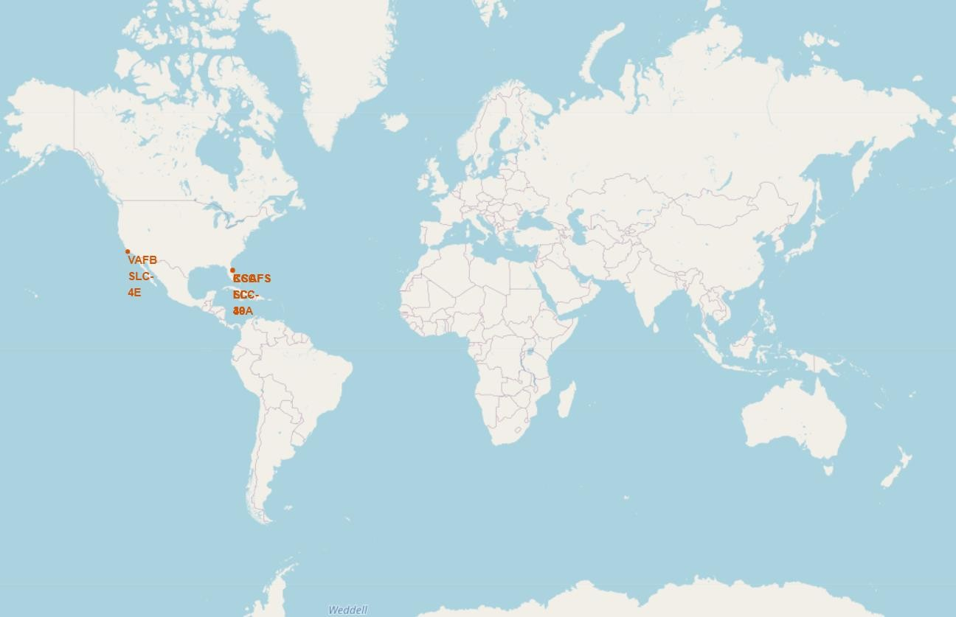
All launch sites global map markers
<Folium map screenshot 1>
We can see that the SpaceX launch sites are in the United States of America coasts. Florida and California

Slide 37
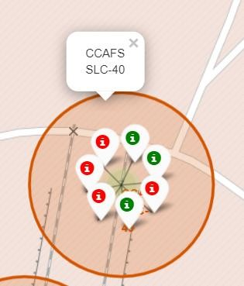
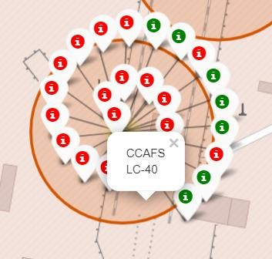
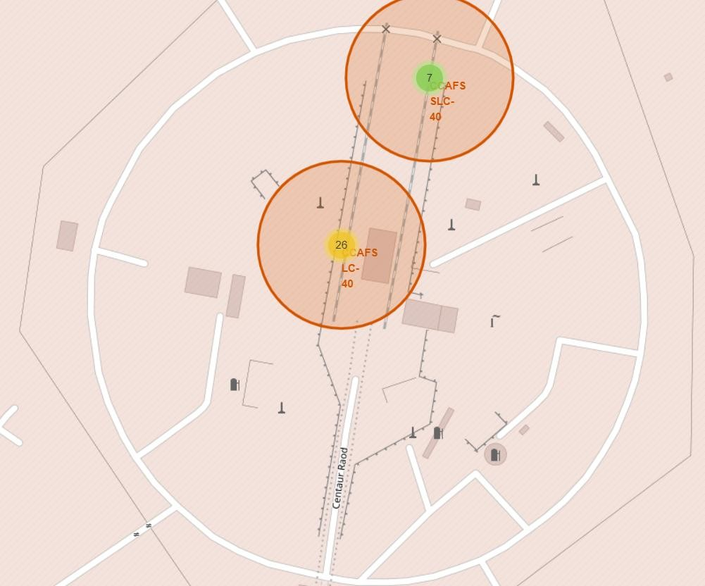
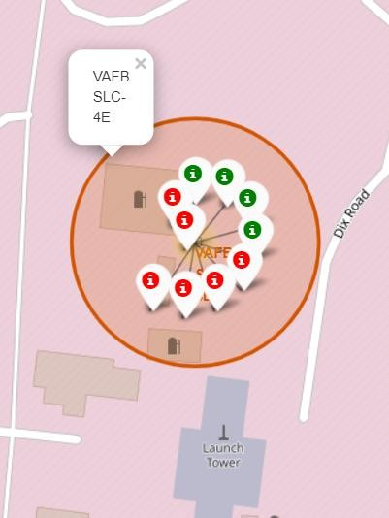
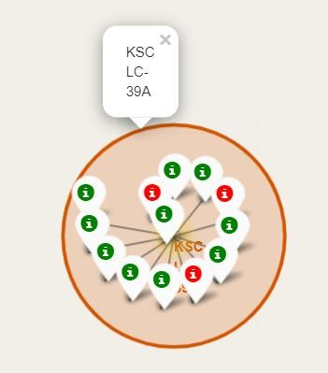
Colour Labelled Markers
California Launch Site
37
Florida Launch Sites
Green Marker shows successful Launches and Red Marker shows Failures

Slide 38
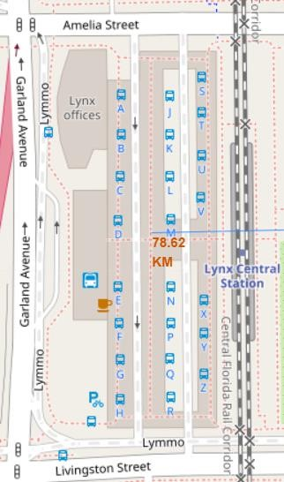
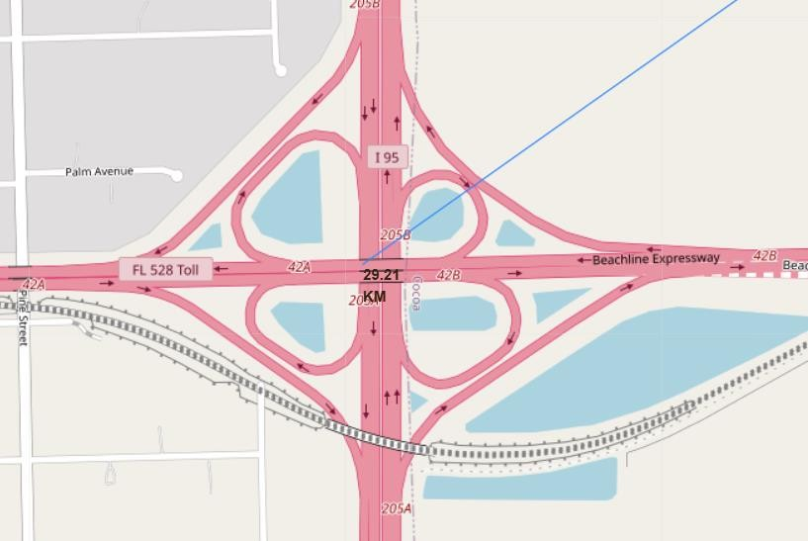
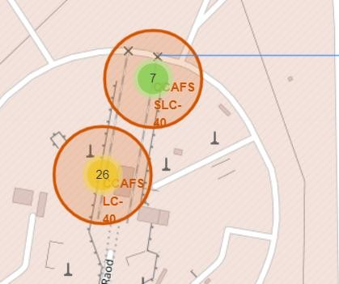
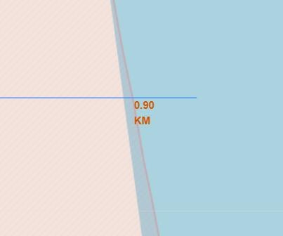
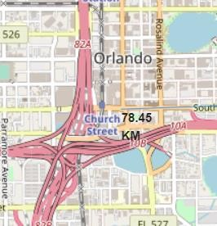
Working out Launch Sites distance to landmarks to find trends with Haversine formula using CCAFS-SLC-40 as a reference
Distance to
closest Highway
Distance to coast
Are launch sites in close proximity to railways? No
Are launch sites in close proximity to highways? No
Are launch sites in close proximity to
coastline? Yes
Do launch sites keep certain distance away from cities? Yes
Distance to Railway Station
Distance to Coastline
Distance to City

Slide 39

Dashboard with Plotly Dash

Slide 40
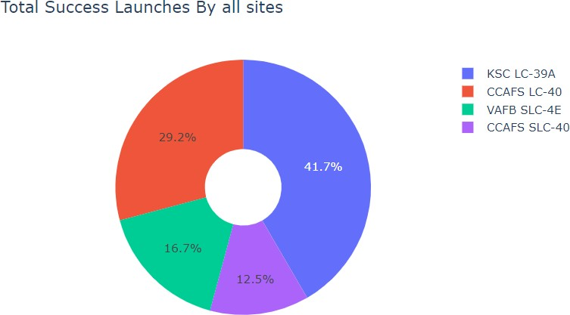
DASHBOARD – Pie chart showing the success percentage achieved by each launch site
<Dashboard screenshot 1>
We can see that KSC LC-39A had the
most successful launches from all the sites

Slide 41
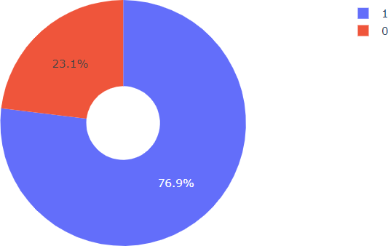
DASHBOARD – Pie chart for the launch site with highest launch success ratio
KSC LC-39A achieved a 76.9% success rate while getting a 23.1% failure rate

Slide 42
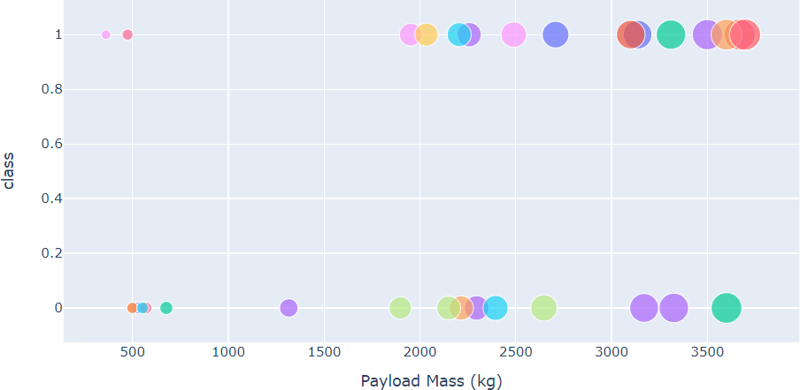
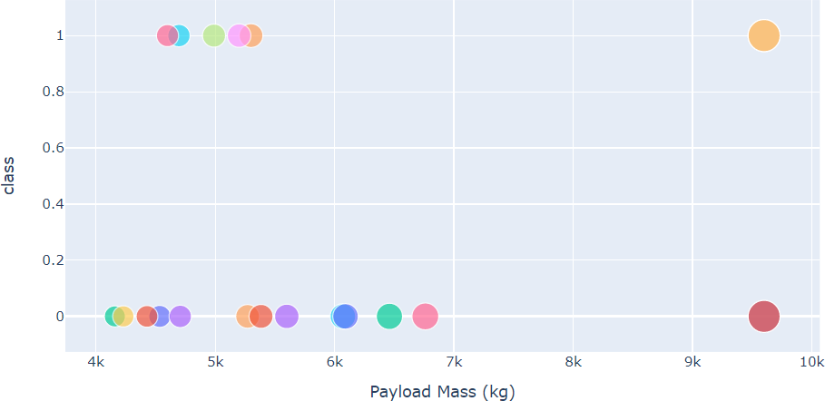
DASHBOARD – Payload vs. Launch Outcome scatter plot for all sites, with different payload selected in the range slider
<Dashboard screenshot 3>
Low Weighted Payload 0kg – 4000kg
Heavy Weighted Payload 4000kg – 10000kg
We can see the success rates for low weighted payloads is higher than the heavy weighted payloads

Slide 43

Predictive analysis (Classification)

Slide 44
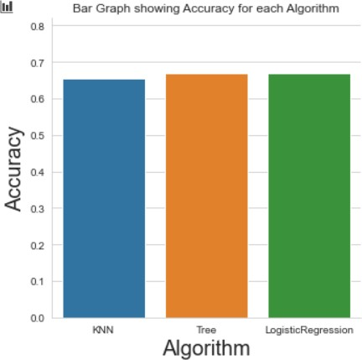
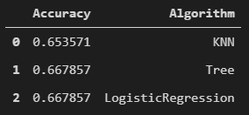
Classification Accuracy using training data
As you can see our accuracy is extremely close but we do have a winner its down to decimal places! using this function
The tree algorithm wins!!
After selecting the best hyperparameters for the decision tree classifier using the validation data, we achieved 83.33% accuracy on the test data.
44

Slide 45
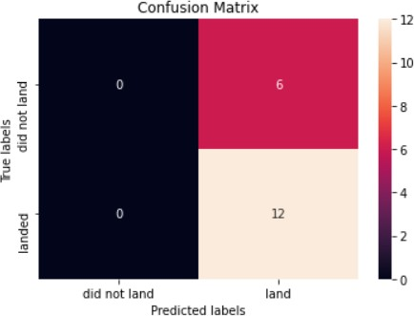
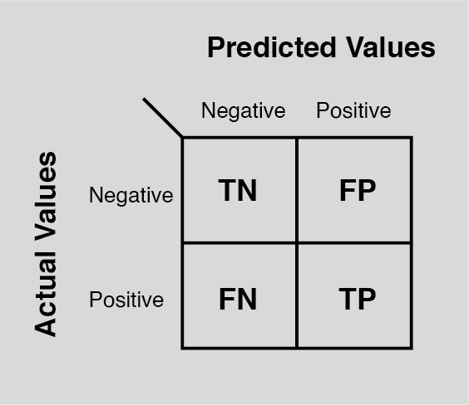
Confusion Matrix for the Tree
Examining the confusion matrix, we see that Tree can distinguish between the different classes. We see that the major problem is false positives.

Slide 46

Conclusion
CONCLUSION
The Tree Classifier Algorithm is the best for Machine Learning for this dataset
Low weighted payloads perform better than the heavier payloads
The success rates for SpaceX launches is directly proportional time in years they will eventually perfect the launches
We can see that KSC LC-39A had the most successful launches from all the sites
Orbit GEO,HEO,SSO,ES-L1 has the best Success Rate

Slide 47
Appendix
Haversine formula
ADGGoogleMaps Module (not used but created)
Module sqlserver (ADGSQLSERVER)
PythonAnywhere 24/7 dashboard
APPENDIX

Slide 48


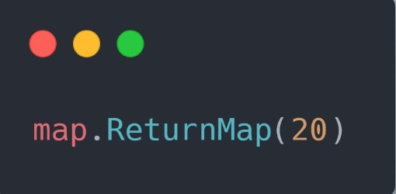
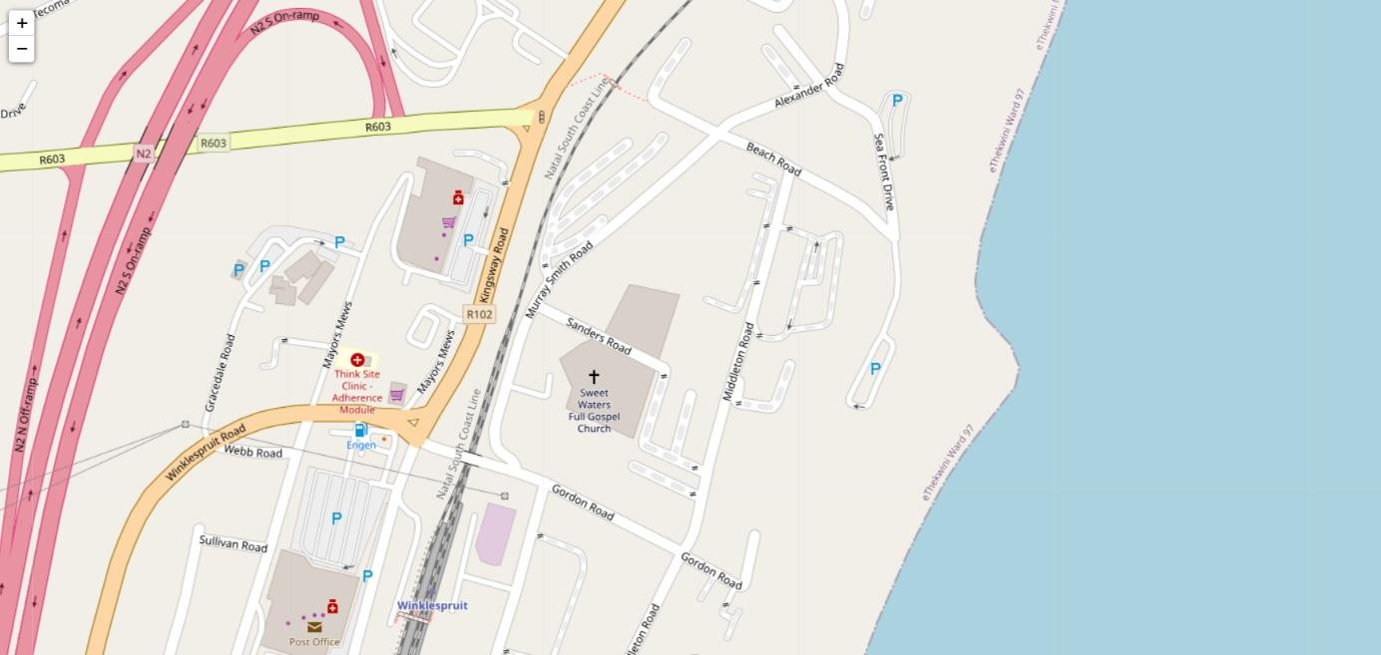
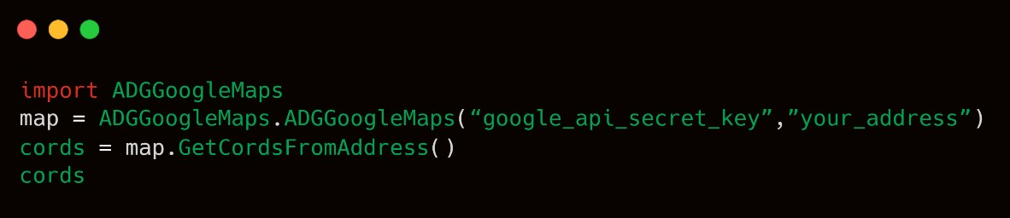
ADGGoogleMaps Module
Introduction
This is a python class I designed to make my life easier and others when getting coordinates from addresses and producing a Folium Python Map in a Jypyter Notebook. This class processing is powered by the Google Geocoding API.
Prerequisites
Sign up for a Google Geocoding API Set up a Google API Key
Head to library under APIs & Services and add Geocoding API
Requirements
Google API Secret (API Key)
Python Usage Documentation
Getting Cords
Simple arguments to follow by the object
init (self,api_key,address) – Look at following usage for guidance
Returning Folium Python Map in Jypyter
Notebook
assuming you declared mapclass in 1.
.ReturnMap(size)
this function returns this Folium map in the Jypyter Notebook
This returns a list with your coordinates of that
address example
[‘longitude’,’latitude’]
48

Slide 49
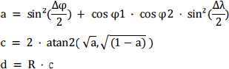
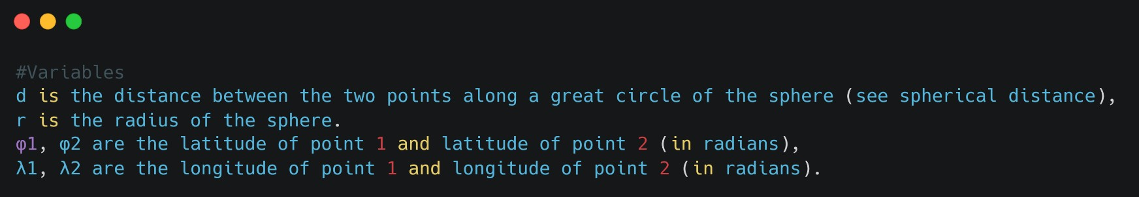
Haversine formula
Introduction
The haversine formula determines the great-circle distance between two points on a sphere given their longitudes and latitudes. Important in navigation, it is a special case of a more general formula in spherical trigonometry, the law of haversines, that relates the sides and angles of spherical triangles.
Usage
Why did I use this formula? First of all, I believe the Earth is round/elliptical. I am not a Flat Earth Believer! Jokes aside when doing Google research for integrating my ADGGoogleMaps API with a Python function to calculate the distance using two distinct sets of {longitudinal, latitudinal} list sets. Haversine was the trigonometric solution to solve my requirements above.
Formula
49

Slide 50
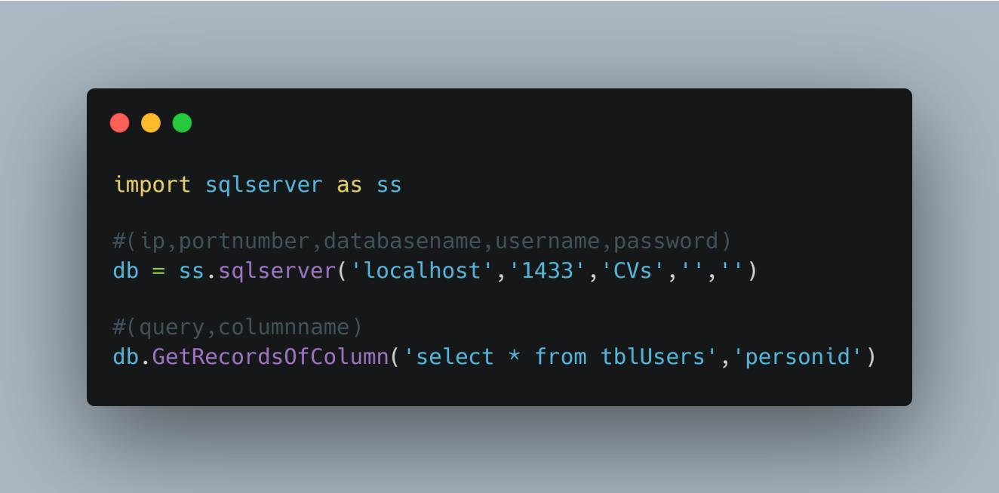
ADGSQLSERVER
Introduction
basically I just wanted an easier way to get my data into my python programming by coding my own module powered by ODBC to simplify my code
Implementation
Pull data from columns Extract Records
Run Stored Procedures
….
GitHub
50

Slide 51
Python Anywhere
Introduction
Python Anywhere Link URL Link to live website
I wanted to put my python website running 24/7 on the cloud so anyone can view it then I came across PythonAnywhere.
Implementation
We run Flask in /www/ on the docker Linux container
We have two files flask_app.py , wsgi.py
These are the files that run our website
Pricing
Free but we are restricted to hitting the renew button every 3 months and we cannot link the domain up to our own private domain. We only can run one instance of a website per month.
51

